Slide 1
High-throughput evaluation of SOFC electrode material composition gradients
A case study with La_{0.6}Sr_{0.4}Co_{1-x}Fe_{x}O_{3-δ}
Chris Kucharczyk Group Meeting Dec. 12 2016

Slide 2
Administrative notes
Shared files (e.g. group presentations) are migrating to box.northwestern.edu
Create an account ASAP so I can share group folders with you

Slide 3
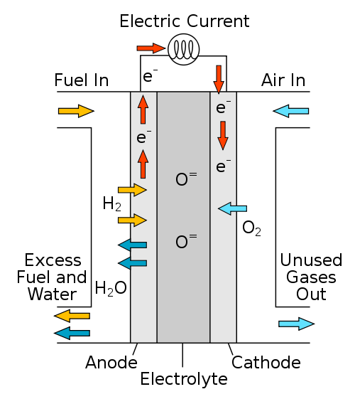



Motivation
Solid oxide fuel cells are good:
efficient, fuel flexible, cheap material construction
Cathodes are bad:
high polarization resistance
low power density
require high temperatures and expensive material construction
Research aims:
Understand what makes a cathode material “good”
Discover new, better cathode materials faster
$$H_{2}+O^{2−}→H_{2}O+2e^{−}$$
$$\frac{1}{2}O_{2}+2e^{−}→O^{2−}$$
$$H_{2}+\frac{1}{2}O_{2}→H_{2}O$$

Slide 4
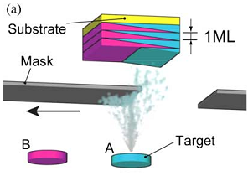



Approach: Northwestern/UMD Collaboration
electrode film
$$\sim 200 nm$$
electrolyte (YSZ, BZY…)
$$300 μm$$
electrolyte (YSZ, BZY…)
$\sim 100 μm$
porous, high-activity counterelectrode
Al₂O₃
H. Koinuma and I. Takeuchi, Nature Materials (2004)
Heated stage
Pulsed laser deposition (PLD) with motorized shutter | Photolithography + ion milling | Environmental scanning electrical impedance probe
Generate dense gradient oxide films | Pattern precise gradient geometries | Measure impedance spectra and extract meaningful material parameters

Slide 5
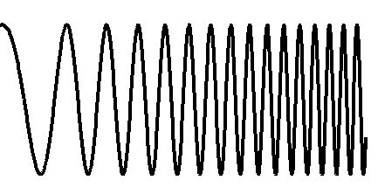


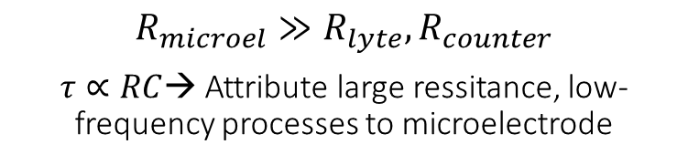
Microelectrode impedance spectroscopy
Pt-Ir probe tip
tip diameter $≈5 μm$
Nyquist plot
Resolve features with different time constants
$$Z\left(ω\right)=\frac{V\left(ω\right)}{I\left(ω\right)}$$
Electronically isolated electrodes
electrolyte (YSZ)
10 kHz to 3 mHz
Extract information by fitting to a model circuit
Uniform gas environment
porous, high-activity counterelectrode
$$R_{microel}≫R_{lyte}, R_{counter}$$
$τ∝RC$→ Attribute large ressitance, low-frequency processes to microelectrode
Decreasing ω

Slide 6
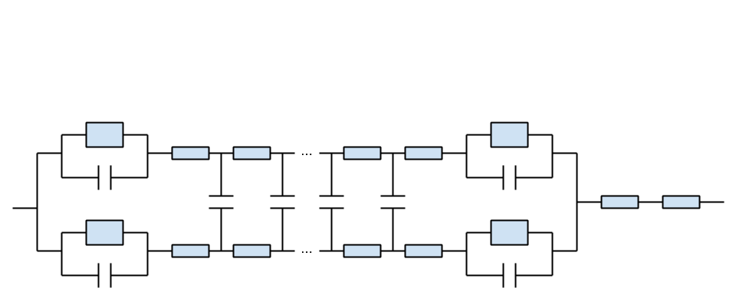
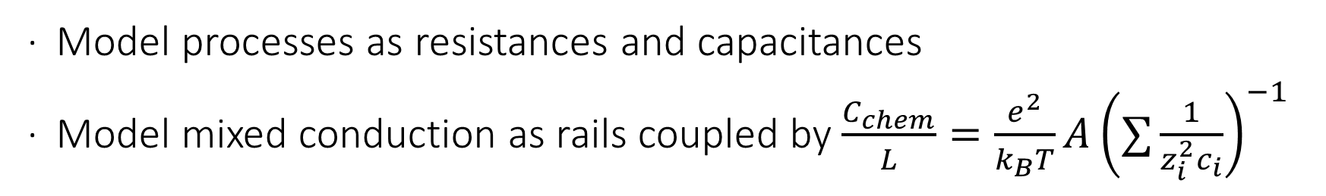
Mixed-conducting microelectrode circuit model
Surface
Bulk
Interface
dR_{ion}
Ions
Electrolyte
dC_{chem}
Counterelectrode
Electrons
dR_{eon}
After J. Jamnik & J. Maier. PCCP (2001),
W. Lai & S. M. Haile. PCCP (2005),
and W. Chueh, Caltech Thesis
Model processes as resistances and capacitances
Model mixed conduction as rails coupled by $\frac{C_{chem}}{L}=\frac{e^{2}}{k_{B}T}A{\left(∑\frac{1}{z_{i}^{2}c_{i}}\right)}^{−1}$

Slide 7
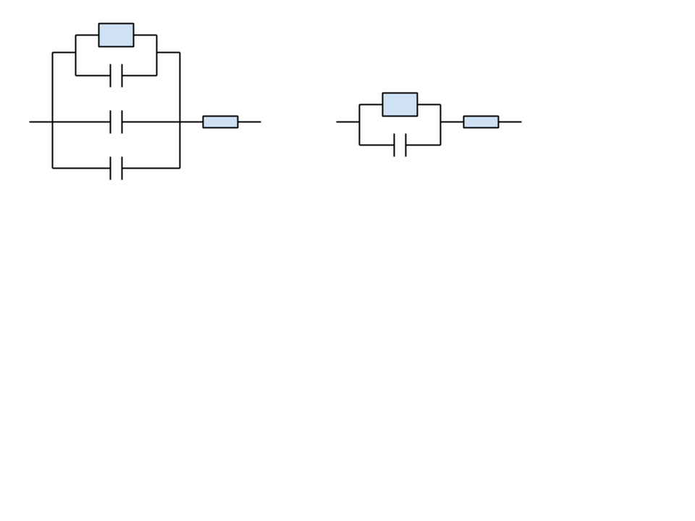









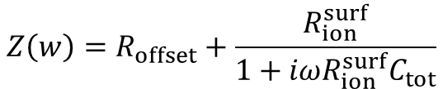


Simplifying properties
$$R_{ion}^{surf}$$
$$R_{ion}^{surf}$$
Surface
$$C_{ion}^{surf}$$
$$f=\frac{1}{RC}$$
$$R_{offset}$$
$$C_{chem}$$
$$C_{tot}$$
Bulk
$$R_{offset}$$
$$C_{int}^{eon}$$
Interface
$$R_{ion}^{surf}$$
$$R_{offset}$$
$$Z\left(w\right)=R_{offset}+\frac{R_{ion}^{surf}}{1+iωR_{ion}^{surf}C_{tot}}$$
If C_{chem} >> C_{int}, C_{surf}, C ~ C_{chem}
Scaling of these fitted parameters with geometry gives clues as to the dominant mechanisms at play

Slide 8
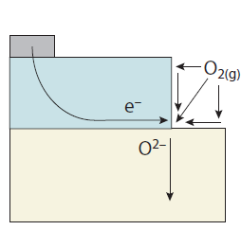
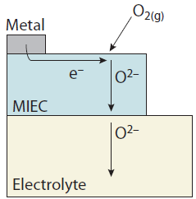
Why this approach is useful
Multiple gradients (composition, diameter, thickness…) in multiple environments yields rich electrochemical information
Diameter or thickness variation → electrochemical pathway
Composition variation → optimization
Oxygen atmosphere variation → nonstoichiometry
Temperature variation → Arrhenius behavior
3PB pathway
2PB pathway
W. C. Chueh & S. M. Haile. Annual Review of Chemical and Biomolecular Engineering (2012)

Slide 9
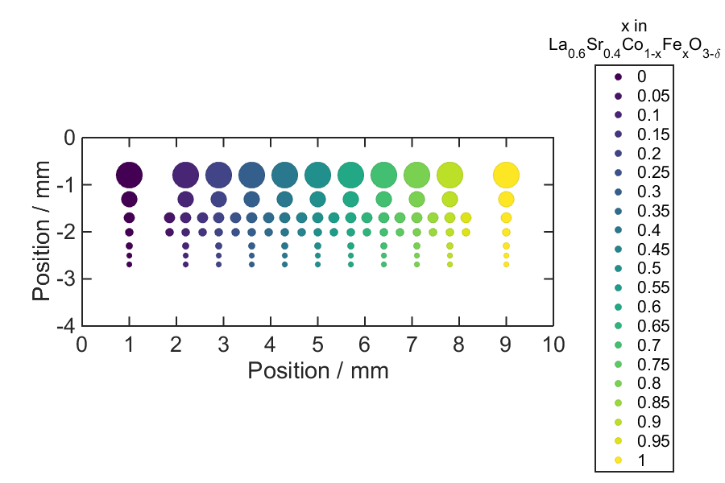
Case Study: La_{0.6}Sr_{0.4}Co_{1-x}Fe_{x}O_{3-δ}
Microdot
diameters
500µm
300µm
200µm
150µm
125µm
100µm
100µm

Slide 10
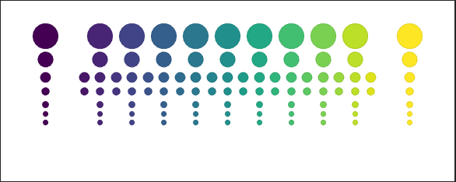
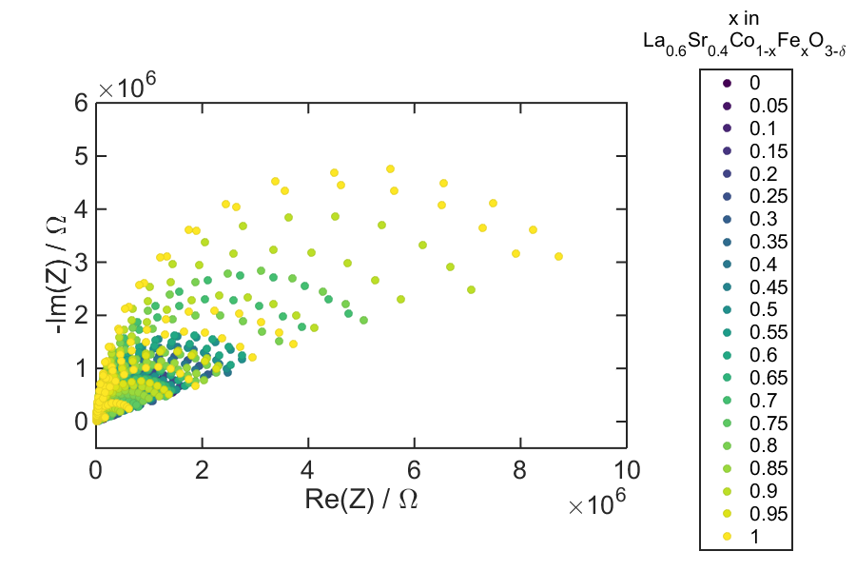
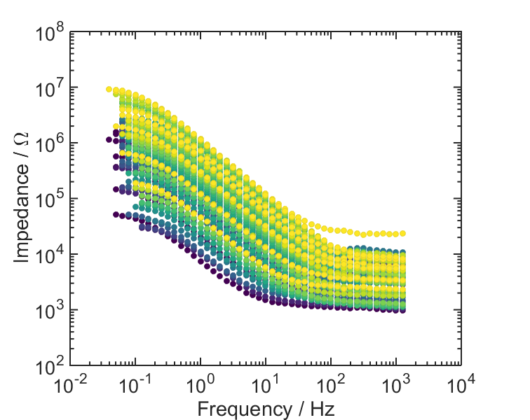
Nyquist and bode plots
LSC
LSF
750°C
1 atm O₂
750°C
1 atm O₂

Slide 11
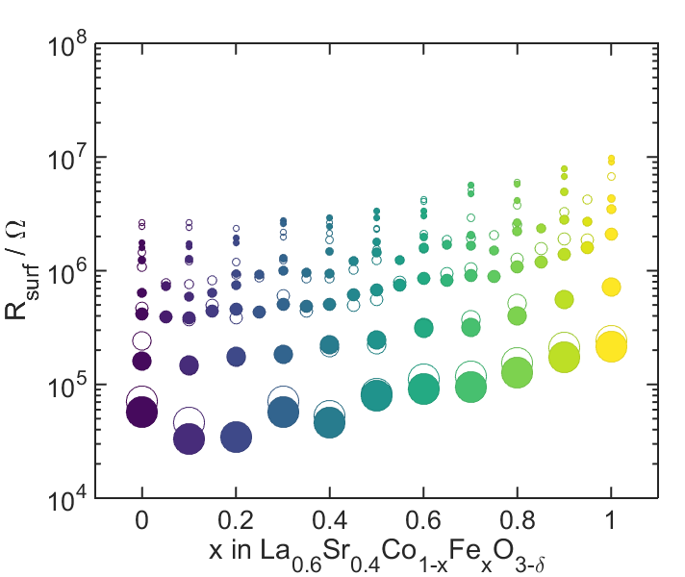
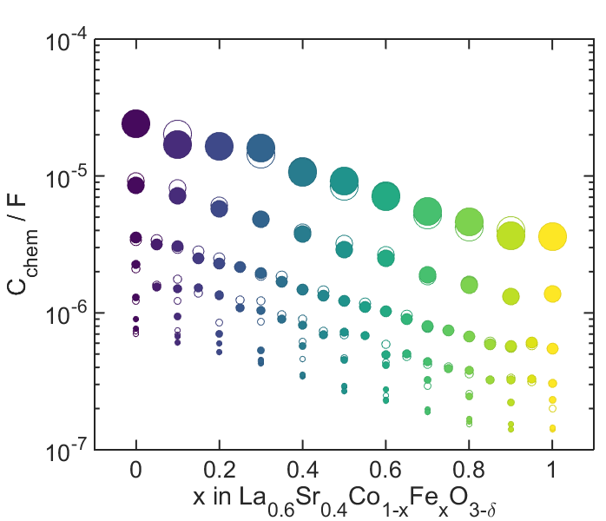


Resistance and capacitance
LSC
LSF
$$R_{ion}^{surf}$$
$$C_{chem}$$
750°C
1 atm O₂
100-500µm microdots
x 4 temperatures!
x 5 pO₂ atmospheres!

Slide 12
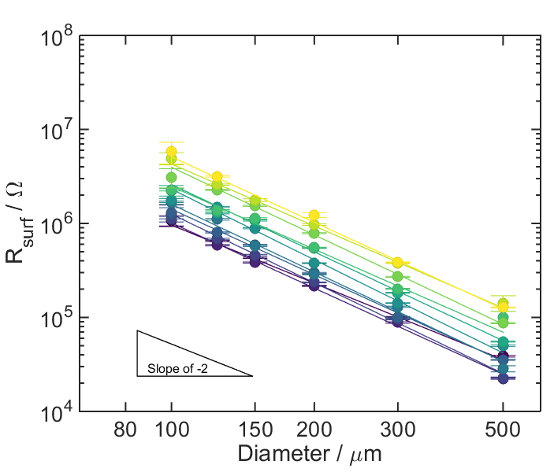
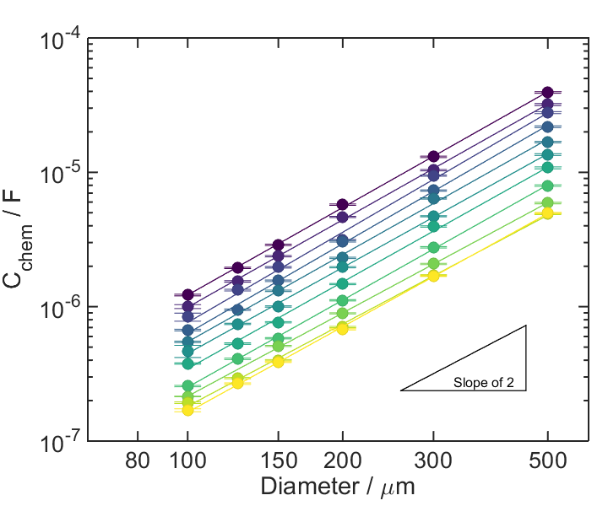
Geometric dependence
LSC
LSF
$$R_{ion}^{surf}$$
$$C_{chem}$$
775°C
1 atm O₂
775°C
0.2 atm O₂
A slope of ~-2 suggests we are, indeed, 2PB limited
As expected, capacitance scales with dot area

Slide 13
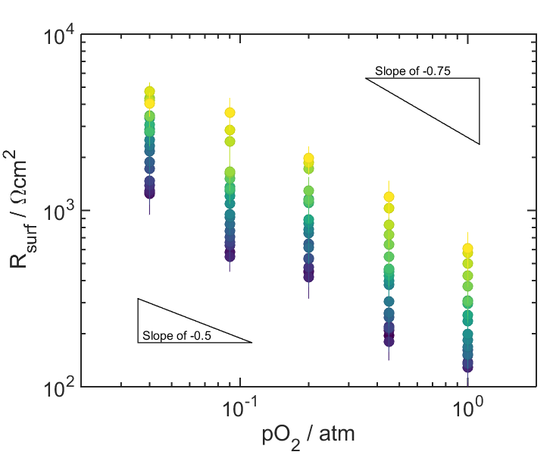
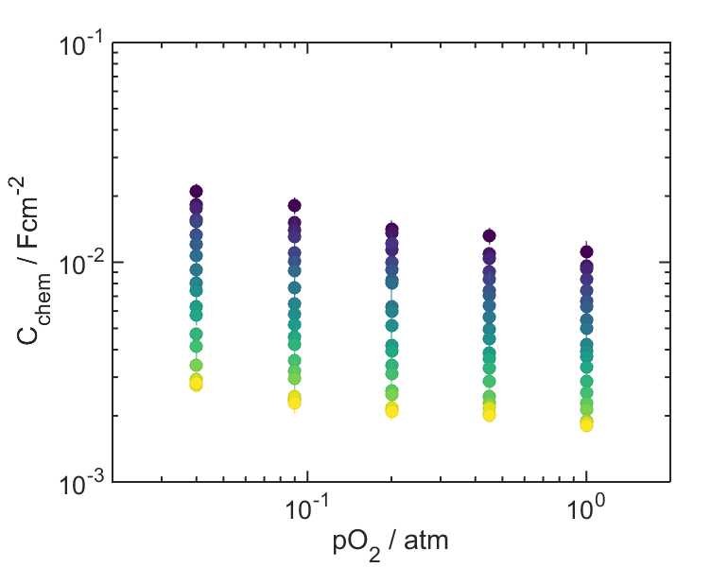
Atmosphere dependence
LSC
LSF
$$R_{ion}^{surf}$$
$$C_{chem}$$
750°C
750°C
-0.5 < slope < -0.75 → diatomic oxygen likely involved in rate-determining step (Chueh 2012)
Power law fitting can obtain absolute oxygen non-stoichiometry

Slide 14
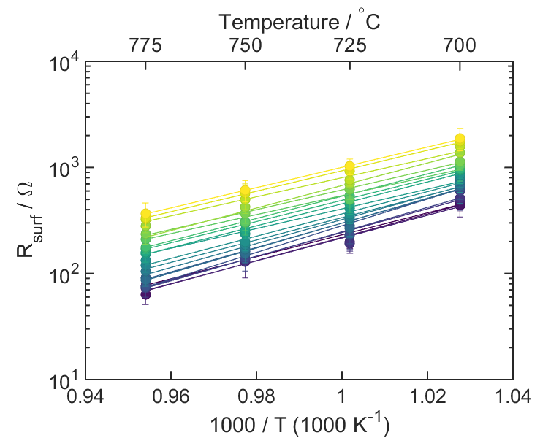
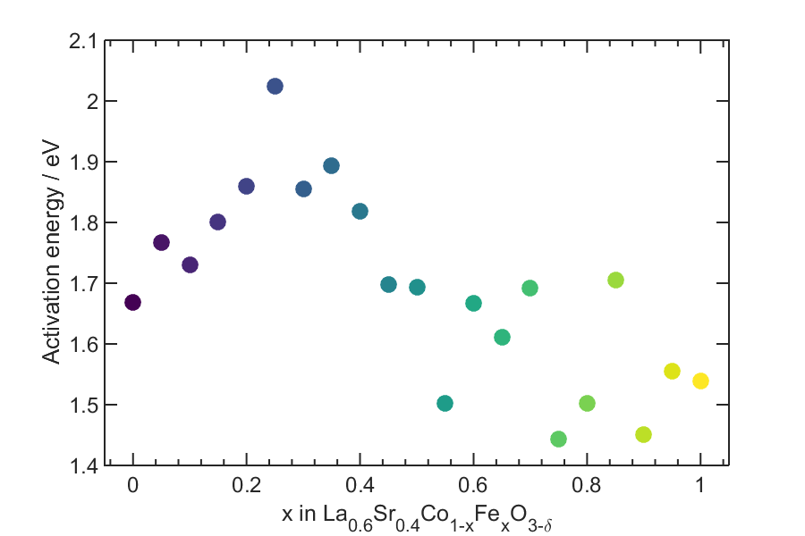
Arrhenius behavior
LSC
LSF

Slide 15
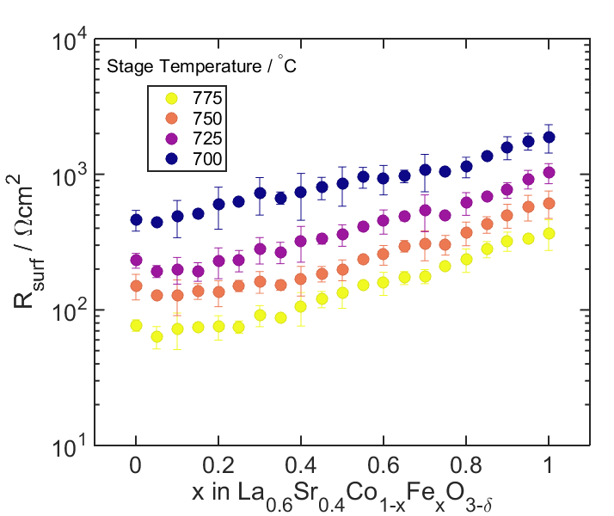
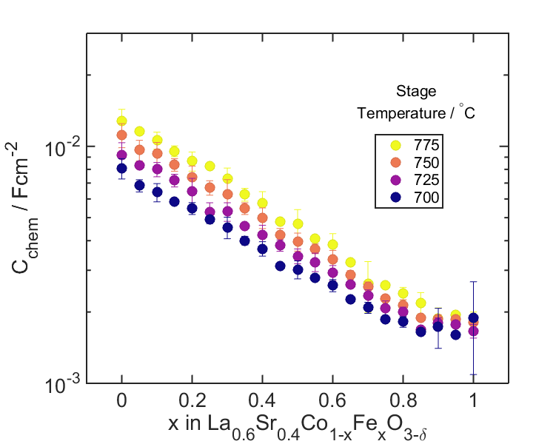
Temperature dependence
LSC
LSF
$$R_{ion}^{surf}$$
$$C_{chem}$$
Can see onset of oxygen vacancy creation!

Slide 16
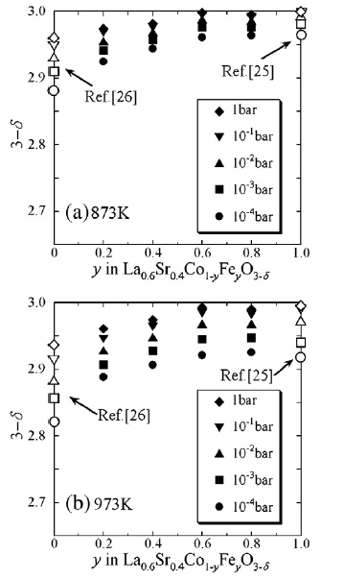
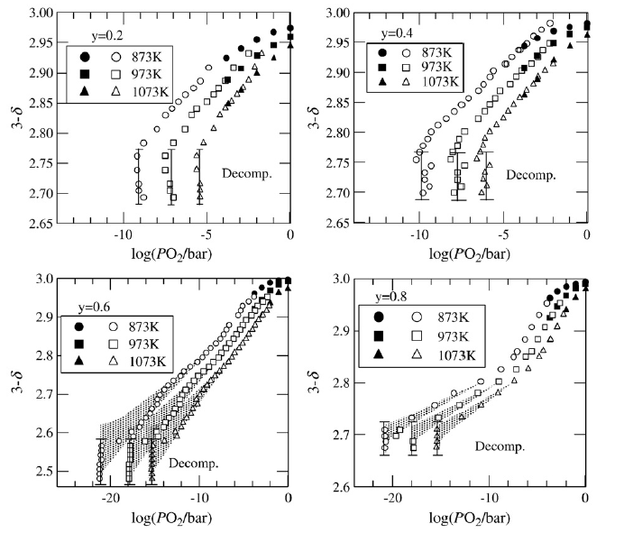
Mizusaki comparison
Hashimoto, S., et al. (2010) Solid State Ionics 181(37-38): 1713-1719

Slide 17
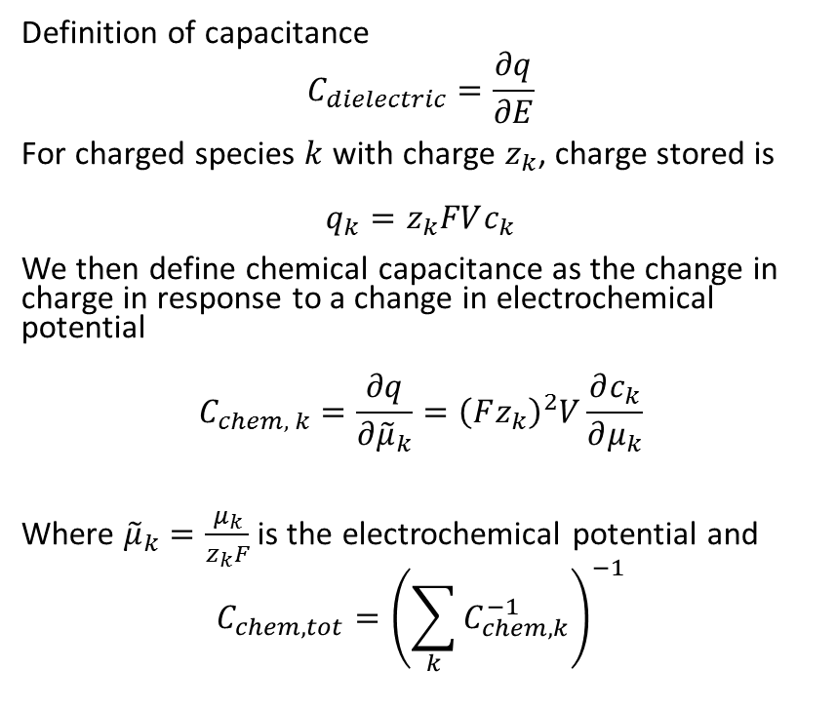
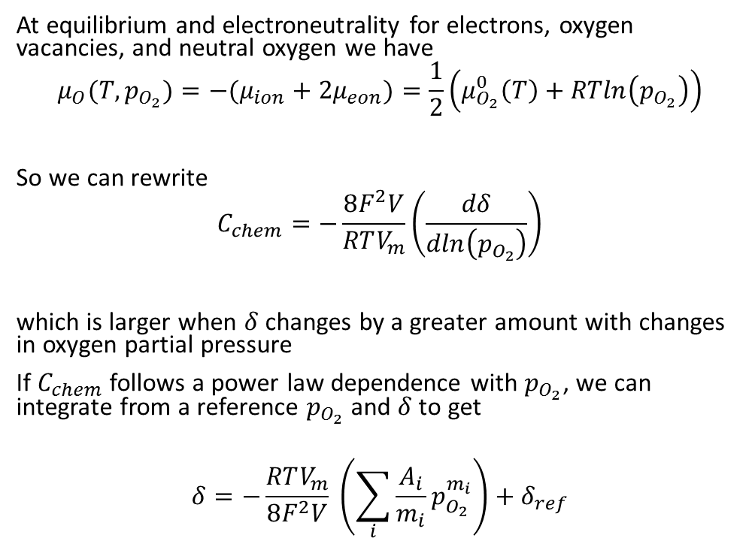
Chemical capacitance calculation
Definition of capacitance
$$C_{dielectric}=\frac{∂q}{∂E}$$
For charged species $k$ with charge $z_{k}$, charge stored is
$$q_{k}=z_{k}FVc_{k}$$
We then define chemical capacitance as the change in charge in response to a change in electrochemical potential
$$C_{chem, k}=\frac{∂q}{∂{\tilde{μ}}_{k}}={\left(Fz_{k}\right)}^{2}V\frac{∂c_{k}}{∂μ_{k}}$$
Where ${\tilde{μ}}_{k}=\frac{μ_{k}}{z_{k}F}$ is the electrochemical potential and
$$C_{chem, tot}={\left(\sum_{k}{C_{chem, k}^{−1}}\right)}^{−1}$$
At equilibrium and electroneutrality for electrons, oxygen vacancies, and neutral oxygen we have
$$μ_{O}(T, p_{O_{2}})=−(μ_{ion}+2μ_{eon})=\frac{1}{2}\left(μ_{O_{2}}^{0}\left(T\right)+RTln\left(p_{O_{2}}\right)\right)$$
So we can rewrite
$$C_{chem}=−\frac{8F^{2}V}{RTV_{m}}\left(\frac{dδ}{dln\left(p_{O_{2}}\right)}\right)$$
which is larger when $δ$ changes by a greater amount with changes in oxygen partial pressure
If $C_{chem}$ follows a power law dependence with $p_{O_{2}}$, we can integrate from a reference $p_{O_{2}}$ and $δ$ to get
$$δ=−\frac{RTV_{m}}{8F^{2}V} \left(\sum_{i}{\frac{A_{i}}{m_{i}}p_{O_{2}}^{m_{i}}}\right)+δ_{ref}$$
Notes:
i.e. change in charge stored on e.g. a parallel plate capacitor with change in applied potential

Slide 18
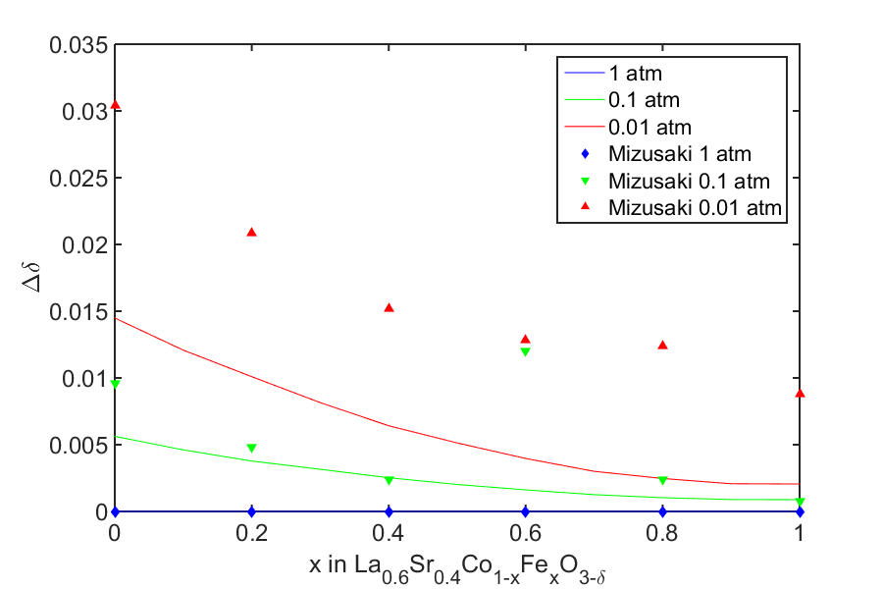
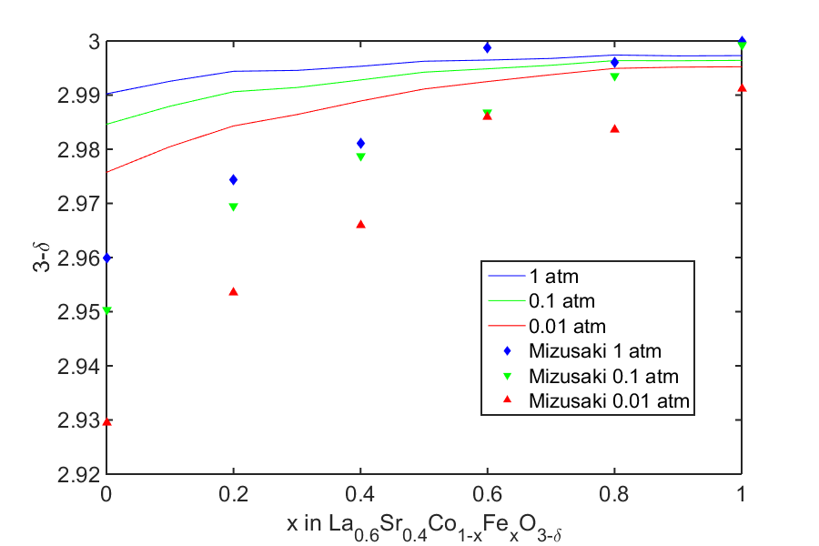
Calculation with C_{chem} data

Slide 19
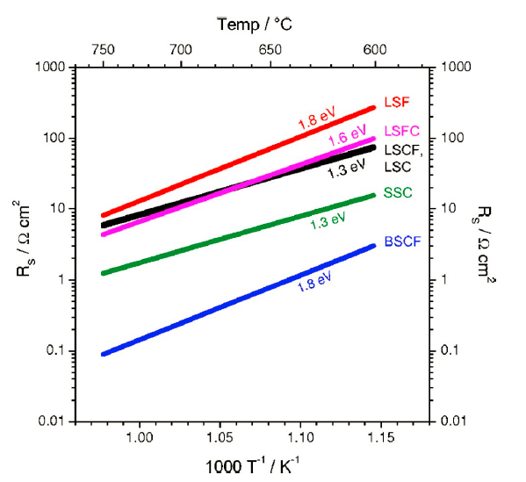
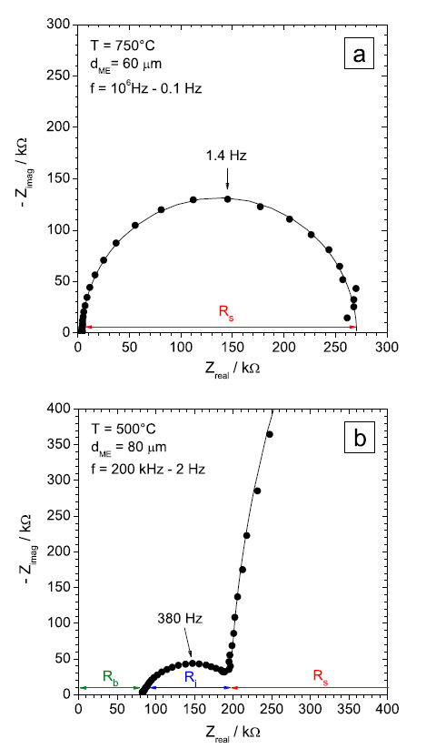
Maier comparison
LSC
LSF
Baumann, F. S., et al. (2006) Solid State Ionics 177(11-12): 1071-1081
Baumann, F. S., et al. (2007) Journal of the Electrochemical Society 154(9): B931-B941

Slide 20
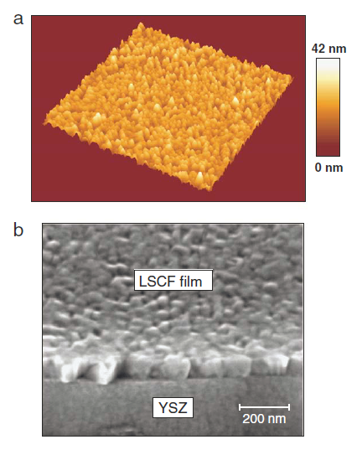
Film comparison
Our dots
250nm thick, < 5nm rms roughness
100-500µm diameter
Their dots
100nm thick, look much rougher
60-80µm diameter (3PB contribution?)
electrolyte (YSZ, BZY…)
porous, high-activity counterelectrode
Al₂O₃
Heated stage
Baumann, F. S., et al. (2006) Solid State Ionics 177(11-12): 1071-1081

Slide 21
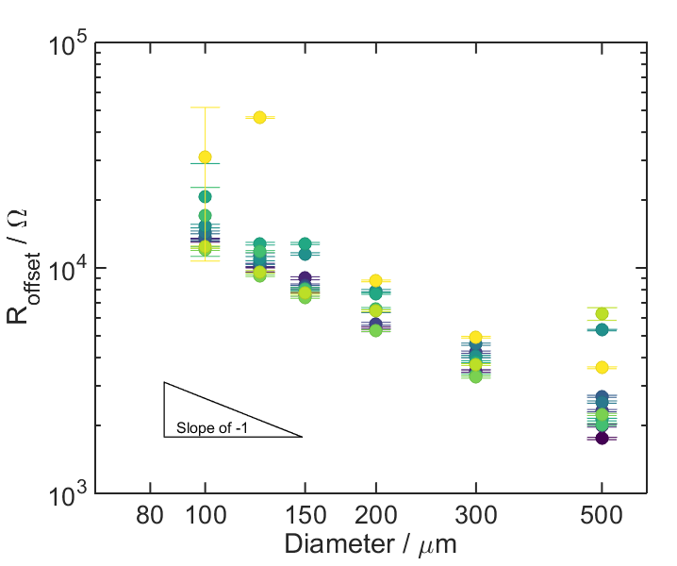
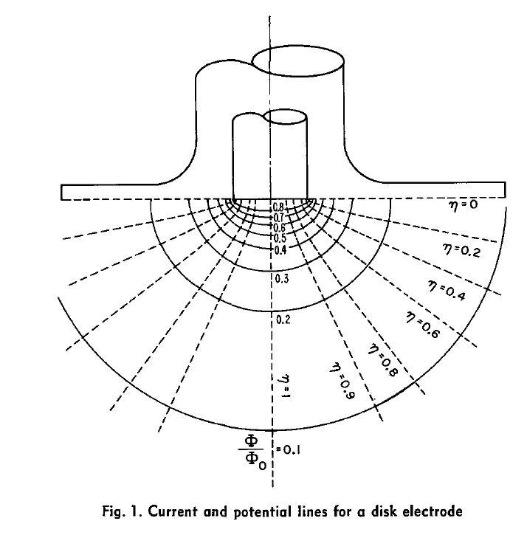
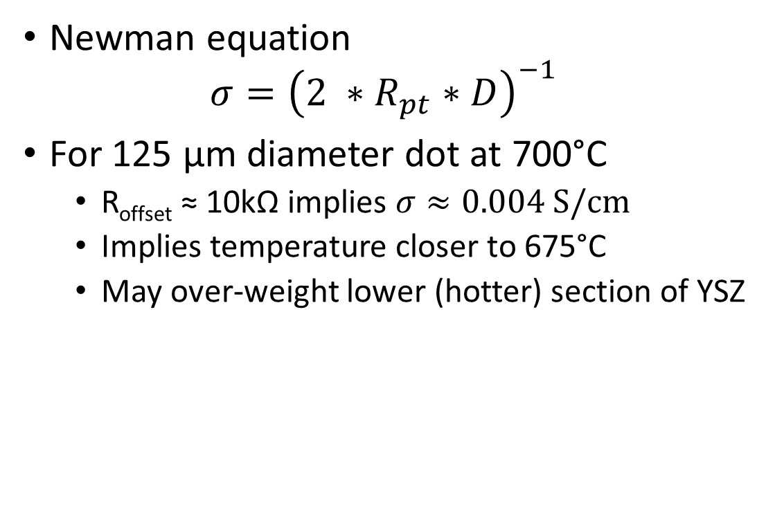
(100) YSZ resistance
700°C
1 atm O₂
Newman equation
$$σ={\left(2 ∗R_{pt}∗D\right)}^{−1}$$
For 125 µm diameter dot at 700°C
R_{offset} ≈ 10kΩ implies $σ≈0.004 S/cm$
Implies temperature closer to 675°C
May over-weight lower (hotter) section of YSZ
Newman, J. (1966) Journal of the Electrochemical Society 113(5): 501-&.

Slide 22
Conclusion
Accurate temperature calculation is vital to complete understanding & comparison to existing results
Pyrometer
Surface thermocouple
Temperature-indicating lacquers
Buried/pressed thermocouple
Next: use Pt paste and Pt-Pt/Rh wires to make a true “surface” thermocouple
Otherwise, data look fantastic!
Next steps:
WDS characterization & composition confirmation
New materials!

Slide 23

Acknowledgements
Dr. Sihyuk Choi
Yangang Liang & Dr. Xiaohang Zhang (UMD)
Professor Ichiro Takeuchi (UMD)
Professor Sossina Haile

